Slide 1




Language Analysis and Computational Linguistics
SESSION
2
THEORY AND LAB
Notes:
Session 2 moves from 'what is language' (Session 1) to 'how do we analyse it', and then to how AI systems understand, generate and interact in natural language.

Slide 2
Session outline
OVERVIEW
I
Language analysis
Paradigmatic and syntagmatic relations; form, function and meaning
II
Levels of linguistic analysis
Phonetics, phonology, morphology, syntax, semantics, pragmatics, discourse, lexicology
III
Artificial intelligence
What AI is, and its sub-disciplines; where NLP fits
IV
NLU, NLG and NLI
Understanding, generation and interaction in natural language
Lab
Hands-on in Python
Collocations and WordNet; a spaCy pipeline by level; a mini NLU → NLG chatbot
SL
Self-learning and assignment
Readings; assignment: the difference between semantics and pragmatics
Learning outcomes. Analyse a sentence at every linguistic level, place NLP within AI, and distinguish NLU, NLG and NLI with examples.
Notes:
Section numbers refer to Bhattacharyya & Joshi, Natural Language Processing (Wiley India, 2023). Session 1 covered §1.1–1.4 in outline; this session goes deeper into the linguistic levels and introduces the three broad capabilities of NLP systems.

Slide 3

Language analysis
I
How linguistic units relate to one another, and what we analyse them for

Slide 4
Two axes of language: syntagmatic and paradigmatic
I · LANGUAGE ANALYSIS
Paradigmatic: selection (“or”)
The
boy
ate
a
mango
Syntagmatic relations
hold between units that are present together in a sequence: the boy + ate + a mango.
Paradigmatic relations
hold between units that could replace one another in the same slot: boy / girl / teacher.
Both ideas come from Saussure (1916), who called them associative and syntagmatic relations.
girl
peeled
banana
teacher
bought
guava
dog
saw
pen
Syntagmatic axis: combination (“and”), units in sequence
“pen” fits the syntagm grammatically but not semantically: paradigms are constrained by meaning too.
Hindi: laṛke ne ām khāyā (boy-ERG mango ate). The syntagm is ordered SOV, yet the same paradigms apply: laṛke / laṛkī / adhyāpak.
Notes:
Draw this on the board: the sentence runs left to right (syntagmatic chain); each slot opens a vertical list of alternatives (paradigm). Ask students to fill paradigms for 'ate' that keep the sentence grammatical, then ones that break it ('slept' needs no object).

Slide 5
Syntagmatic vs paradigmatic, in linguistics and NLP
I · LANGUAGE ANALYSIS
 | SYNTAGMATIC | PARADIGMATIC
Axis | Horizontal: the chain of speech | Vertical: the set of alternatives
Relation | Combination: items present together | Selection: one item chosen, the others absent
Test | Which items co-occur? | Which items can substitute for each other?
Example | Collocation: “strong tea”, not “powerful tea” | strong / weak / hot / sweet tea
NLP use | n-gram language models, collocation extraction, next-word prediction | POS classes, WordNet synonyms and hyponyms, word embeddings
“You shall know a word by the company it keeps.”
This is the bridge used by modern NLP: words that share syntagmatic contexts (the company they keep) turn out to be paradigmatically similar. Word embeddings are built on exactly this idea.
J. R. Firth, 1957
Notes:
Lab Task 1 makes both axes concrete: NLTK collocations (syntagmatic) and WordNet synonyms and hypernyms (paradigmatic). The textbook's chapter on representation traces how NLP moved from discrete to dense (embedding) representations, which rely on the distributional idea.

Slide 6
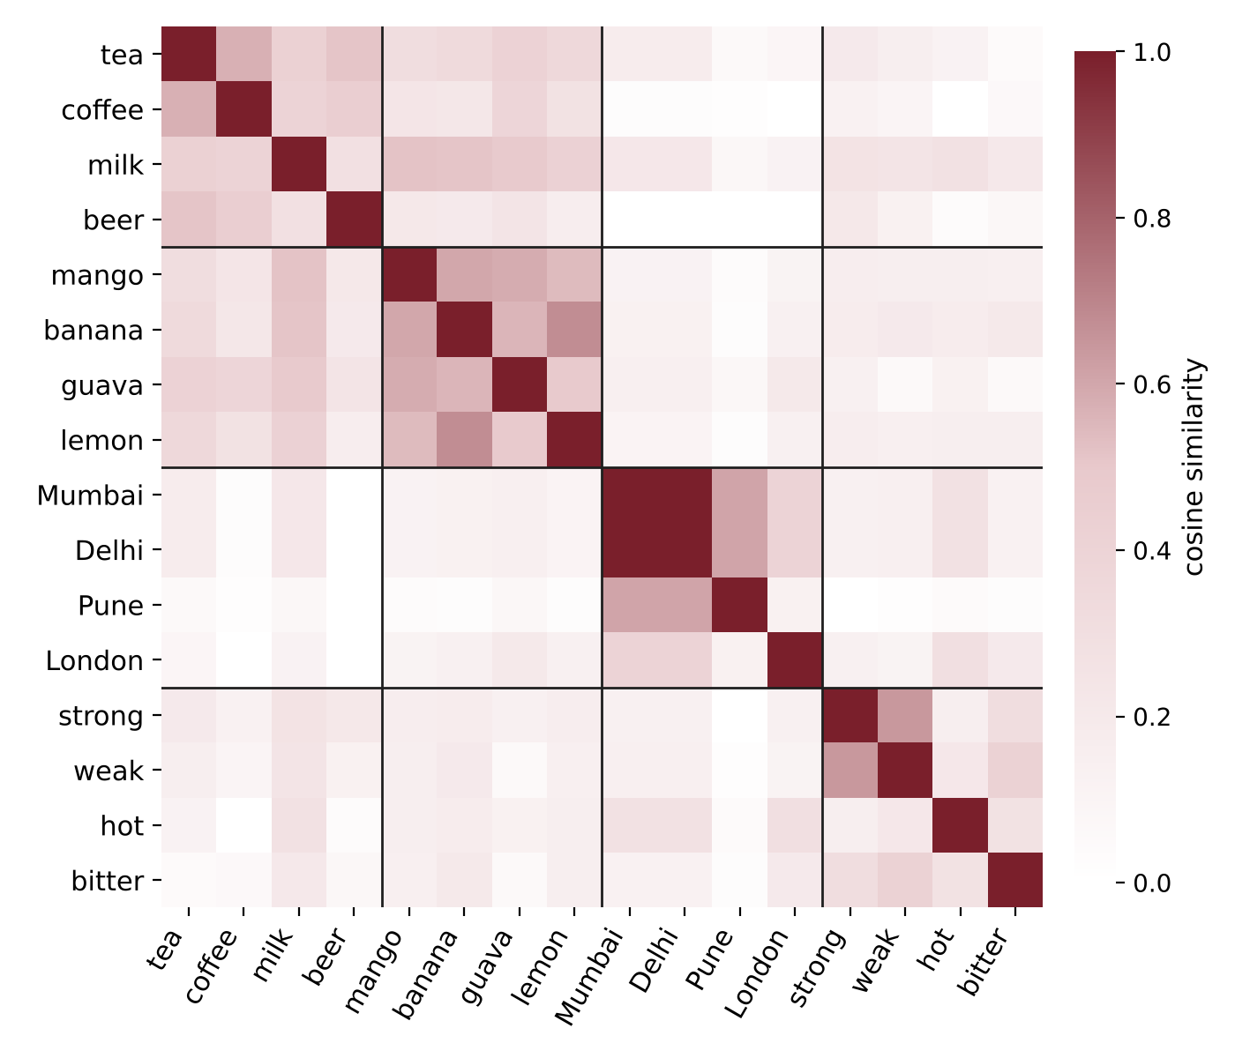
Seeing paradigmatic similarity in word vectors
I · LANGUAGE ANALYSIS
How to read it
Each cell compares two words. Darker means the words occur in more similar contexts.
0.44 – 0.57
average similarity
Same group (drinks, fruits, cities)
0.33
average similarity
Same group (tea modifiers)
0.15
average similarity
Different groups
The link to Firth: vectors are built from syntagmatic company, yet they recover paradigmatic classes: tea and coffee keep the same company, so they end up close.
Data: spaCy en_core_web_md word vectors (real output).
Notes:
Real data: cosine similarities between word vectors from spaCy's en_core_web_md model. Each vector was learned from the contexts a word appears in (its syntagmatic company), yet words from the same paradigm end up similar: the darker blocks on the diagonal. Ask students why Mumbai and Delhi are almost identical (they appear in the same kinds of sentences) and why 'hot' is not close to 'strong' (they modify different things).

Slide 7



Form, function and meaning
I · LANGUAGE ANALYSIS
Form
Function
Meaning
What the unit looks or sounds like
What role it plays
What it conveys
its sounds, spelling, morphemes and word order
grammatical (subject, object, plural) or communicative (question, request)
its literal sense and, in context, what the speaker intends
ONE UTTERANCE, THREE ANALYSES
 | “CAN YOU PASS THE SALT?” | “THE BOY ATE A MANGO.”
Form | Interrogative: auxiliary before subject, rising intonation | Declarative: Det N V Det N, SVO order, past tense -ed (ate)
Function | A request (directive speech act), not a question | Subject = the boy, object = a mango; a statement
Meaning | The speaker wants the hearer to pass the salt | A past eating event: agent boy, patient mango
Notes:
Linguistic analysis always asks three questions of a unit: what is its form, what job does it do, and what does it mean? NLP systems receive only form (characters or sound); function and meaning must be inferred.

Slide 8
Form and function do not map one-to-one
I · LANGUAGE ANALYSIS
One form, many functions
One function, many forms
cats
-s marks plural on a noun
Function: asking someone to close the door
Close the door.
imperative form
runs
-s marks third person singular present
Could you close the door?
interrogative form
Ravi's
-'s marks possession
It's cold in here.
declarative form
Ravi ko kitāb do
ko marks the recipient (dative)
Darvāzā band kar do.
Hindi imperative
billī ko dekhā
ko marks a definite object
Why it matters for NLP. A system that reads only form will treat “Can you pass the salt?” as a yes/no question. Mapping form to function and meaning is the core of natural language understanding (Part IV).
Notes:
Form–function mismatch is another source of ambiguity. The Hindi postposition 'ko' is a good example for Indian students: same form, dative or accusative function.

Slide 9

Levels of linguistic analysis
II
Phonetics, phonology, morphology, syntax, semantics, pragmatics, discourse and lexicology

Slide 10
The levels of linguistic analysis at a glance
II · LEVELS OF LINGUISTIC ANALYSIS
UNIT
CENTRAL QUESTION
from sound to meaning in context
Discourse
text, conversation
How do sentences connect?
Pragmatics
utterance in context
What does the speaker mean here?
Semantics
word and sentence meaning
What does it mean literally?
Lexicology
the study of words and the vocabulary cuts across morphology, syntax and semantics
Syntax
phrase, sentence
How are words arranged?
Morphology
morpheme, word
How are words built?
Phonology
phoneme
Which sound contrasts matter?
Phonetics
phone (speech sound)
How are sounds made and heard?
Notes:
Lexicology is drawn alongside rather than inside the stack: words have form (morphology), behave in structures (syntax) and carry meaning (semantics). The next eight slides take each level in turn, each with an example and its NLP counterpart.

Slide 11
Phonetics: the physical sounds of speech
II · LEVELS OF LINGUISTIC ANALYSIS
Phonetics studies speech sounds as physical events: how they are produced, transmitted and perceived.
EXAMPLE · PLACE OF ARTICULATION IN HINDI
tota तोता
dental [t̪]: tongue against the teeth
KEY CONCEPTS
Articulatory how the vocal tract produces sounds (place and manner of articulation)
Acoustic the physical properties of the sound wave (frequency, duration)
Auditory how the ear and brain perceive sounds
IPA the International Phonetic Alphabet, one symbol per sound
ṭamāṭar टमाटर
retroflex [ʈ]: tongue curled back
kal कल
velar [k]: back of the tongue
pānī पानी
bilabial [p]: both lips
English speakers often hear dental and retroflex t as the same sound; Hindi speakers do not.
In NLP. Automatic speech recognition (ASR), text-to-speech (TTS) and pronunciation modelling all start from phonetics.
Notes:
Have students say tota and ṭamāṭar and feel where the tongue touches. Phonetics is universal: it describes any sound a human can make, whatever the language.

Slide 12
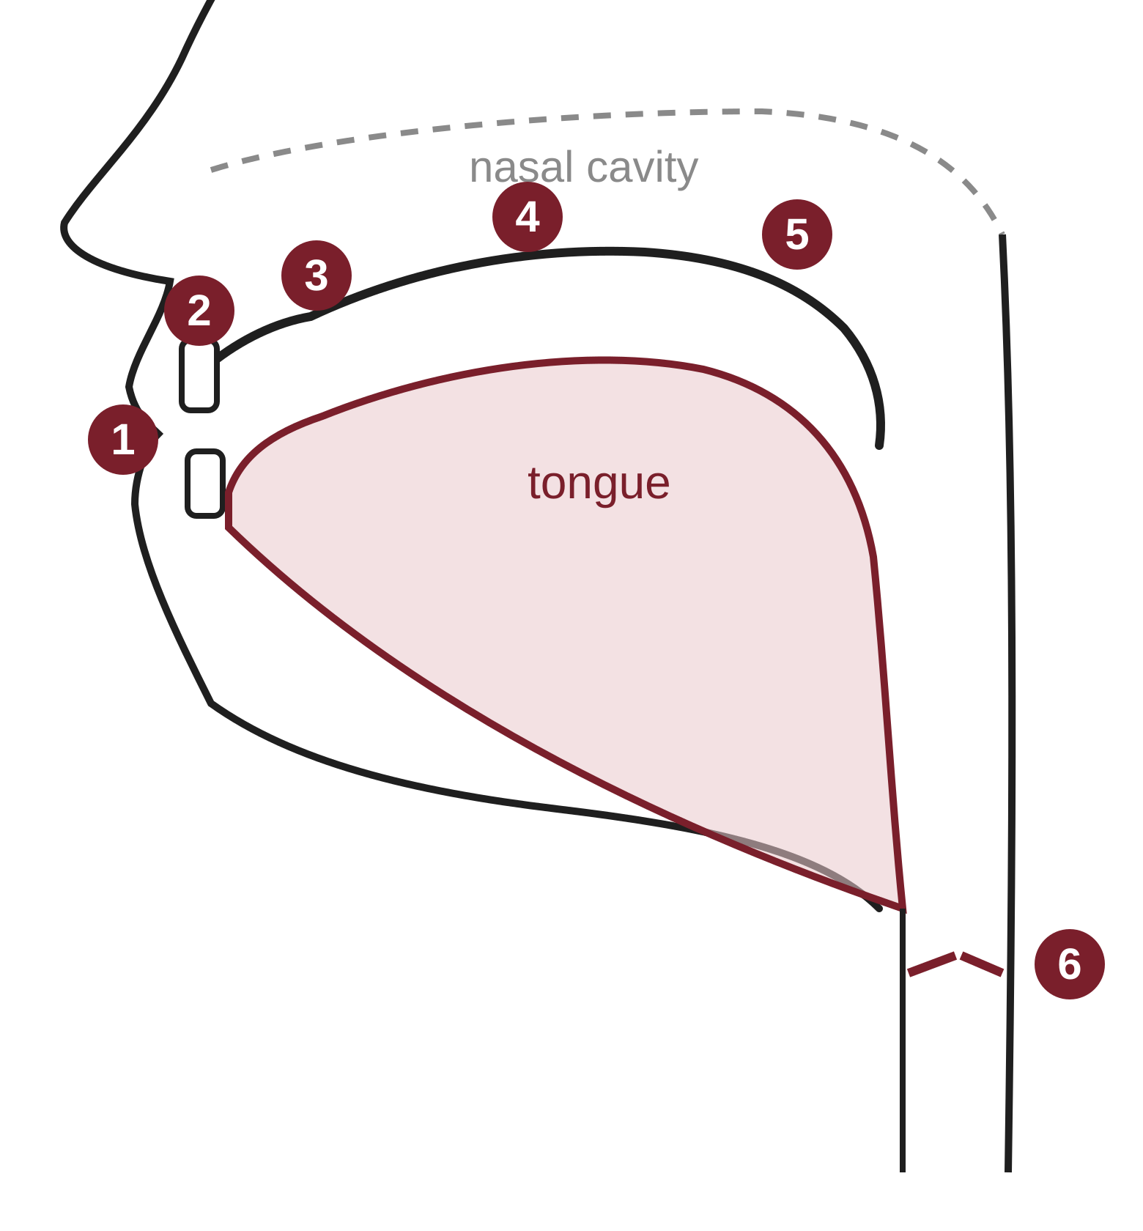
Where speech sounds are made: places of articulation
II · LEVELS OF LINGUISTIC ANALYSIS
PLACE
SOUNDS
HINDI / ENGLISH
1
Lips
bilabial
p, b, m
pānī पानी
2
Teeth
dental
t̪, d̪
tota तोता
3
Alveolar ridge
alveolar
English t, d, n
‘ten’
4
Behind the ridge, toward the hard palate
retroflex (tongue tip curled back)
ʈ, ɖ
ṭamāṭar टमाटर
5
Velum (soft palate)
velar
k, g
kal कल
6
Glottis (vocal folds)
glottal
h
hāth हाथ
Simplified schematic
Notes:
Simplified schematic of the vocal tract (side view, facing left). Walk front to back: lips, teeth, alveolar ridge, hard palate, velum, glottis. For Hindi speakers, the retroflex sounds (ṭ, ḍ) are produced by curling the tongue tip back behind the alveolar ridge; English has no retroflex stops, which is why English speakers often merge dental and retroflex t.

Slide 13
Phonology: the sound system of a language
II · LEVELS OF LINGUISTIC ANALYSIS
Phonology studies which sound differences matter in a particular language, and the patterns sounds follow.
EXAMPLE · ASPIRATION IN HINDI VS ENGLISH
kāl काल
‘time’: unaspirated /k/
KEY CONCEPTS
Phoneme the smallest sound unit that distinguishes meaning, written /p/
Allophone a predictable variant of a phoneme, written [pʰ]
Minimal pair two words differing in one sound only, proving a contrast
Suprasegmentals stress, intonation and tone
khāl खाल
‘skin’: aspirated /kʰ/
pin [pʰɪn]
English: aspirated
spin [spɪn]
English: unaspirated
In Hindi, aspiration changes meaning (two phonemes). In English it never does ([pʰ] and [p] are allophones of one phoneme).
In NLP. Grapheme-to-phoneme conversion for TTS, phoneme-based ASR, and transliteration (Hindi typed in Roman script).
Notes:
Phonetics asks what sounds exist; phonology asks which ones a given language treats as different. The same physical difference (aspiration) is meaningful in Hindi and not in English.

Slide 14
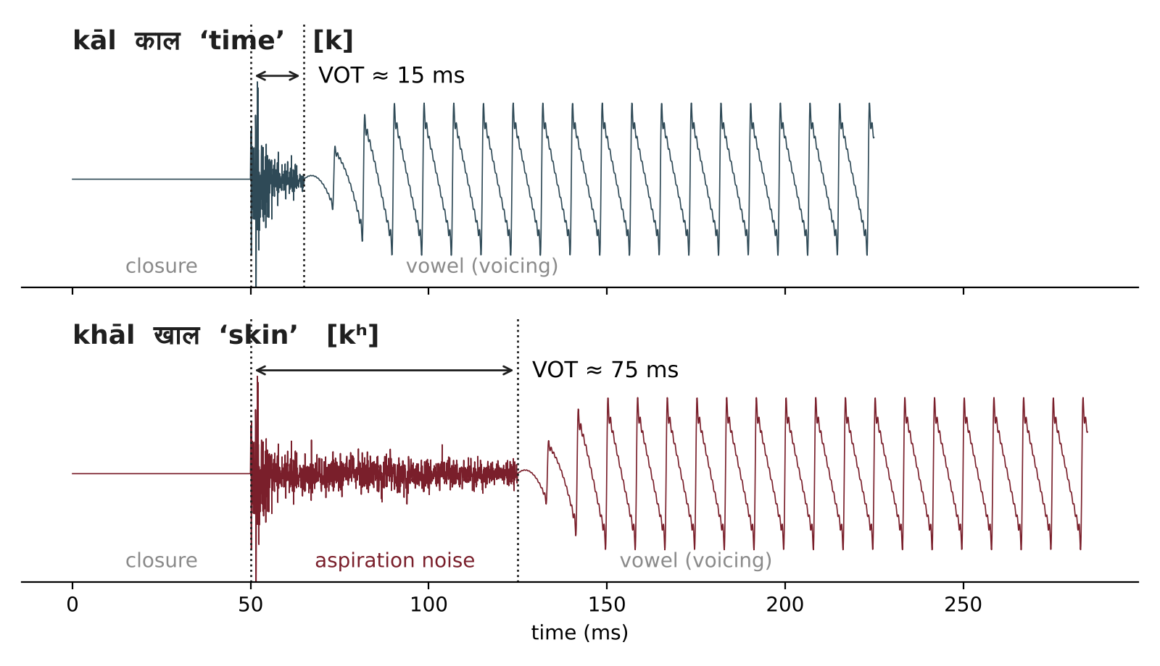
Seeing aspiration: voice onset time
II · LEVELS OF LINGUISTIC ANALYSIS
Voice onset time (VOT)
is the gap between releasing a stop and the start of vocal-fold vibration.
Short VOT → unaspirated [k]
Long VOT with breathy noise → aspirated [kʰ]
HINDI'S FOUR-WAY CONTRAST
क
k
ख
kʰ
ग
g
घ
gʱ
voiceless
aspirated
voiced
breathy voiced
Schematic waveform for teaching
English uses only two of these four categories, so it needs fewer letters for velar stops.
Notes:
The waveform is a schematic generated for teaching, not a recording; real VOT values vary by speaker and context. If you have a microphone in class, record kāl and khāl in a free tool such as Praat and compare the gap. Hindi's four-way contrast (k, kh, g, gh) is a classic example of a phonological system richer than English.

Slide 15
Morphology: the structure of words
II · LEVELS OF LINGUISTIC ANALYSIS
Morphology studies how words are built from morphemes, the smallest units that carry meaning or grammatical function.
EXAMPLE · SEGMENTING WORDS
unhappiness
un- + happy + -ness (derivation)
KEY CONCEPTS
Free / bound happy stands alone; un- and -ness cannot
Inflection changes grammatical form, not the word: play → played
Derivation creates a new word, often a new class: happy → happiness
Compounding joins words: rail + way → railway
played
play + -ed (inflection: past)
laṛkiyā̃ लड़कियाँ
laṛkī + -yā̃ (Hindi plural)
gharāt घरात
ghar + -āt (Marathi: ‘in the house’)
Indian languages are morphologically rich: one Marathi word can carry what English spreads over a phrase.
In NLP. Tokenisation, stemming, lemmatisation and morphological analysers: the bottom layer of the NLP stack.
Notes:
In Session 1 we saw morphology as the bottom layer of NLP. For Hindi and Marathi this layer does far more work than for English, which is one reason Indian-language NLP needs its own tools.

Slide 16
Building words from morphemes
II · LEVELS OF LINGUISTIC ANALYSIS
prefix
root
suffix
Inflection in a Hindi verb
root khā- ‘eat’ + habitual suffix agreeing with the subject
un-
happy
-ness
unhappiness
derivation: adjective → noun
vah (he)
khā
-tā
hai
masculine singular
play
-ed
played
inflection: past tense
vah (she)
khā
-tī
hai
feminine singular
re-
write
-s
rewrites
derivation + inflection
ve (they)
khā
-te
haĩ
masculine plural
laṛkī
-yā̃
laṛkiyā̃ लड़कियाँ
Hindi: plural
ghar
-āt
gharāt घरात
Marathi: ‘in the house’
The root stays fixed; only the suffix changes. A morphological analyser must undo this to find the lemma khānā ‘to eat’.
Notes:
Colour-coding makes morpheme types visible. The Hindi paradigm on the right shows inflection doing agreement work: the suffix changes with the subject's gender and number, while the root khā- stays the same. Ask students to build the same table for 'jā-' (go).

Slide 17
Syntax: the structure of sentences
II · LEVELS OF LINGUISTIC ANALYSIS
Syntax studies how words combine into phrases and sentences, and the rules that govern word order and structure.
EXAMPLE · A CONSTITUENCY TREE
S
KEY CONCEPTS
Constituency words group into phrases (NP, VP, PP)
Dependency each word depends on a head word
Word order English is SVO; Hindi is SOV: laṛke ne ām khāyā
Grammaticality “Mango a ate boy the” uses the same words but is ill-formed
NP
VP
Det
N
V
NP
The
boy
ate
Det
N
a
mango
S → NP VP NP → Det N VP → V NP
In NLP. POS tagging, chunking (shallow parsing) and constituency or dependency parsing (deep parsing).
Notes:
Contrast with Session 1's telescope example: the grammar above licenses one tree for this sentence, but adding 'with a knife' would license two. Lab Task 2 prints spaCy's dependency analysis of a sentence.

Slide 18
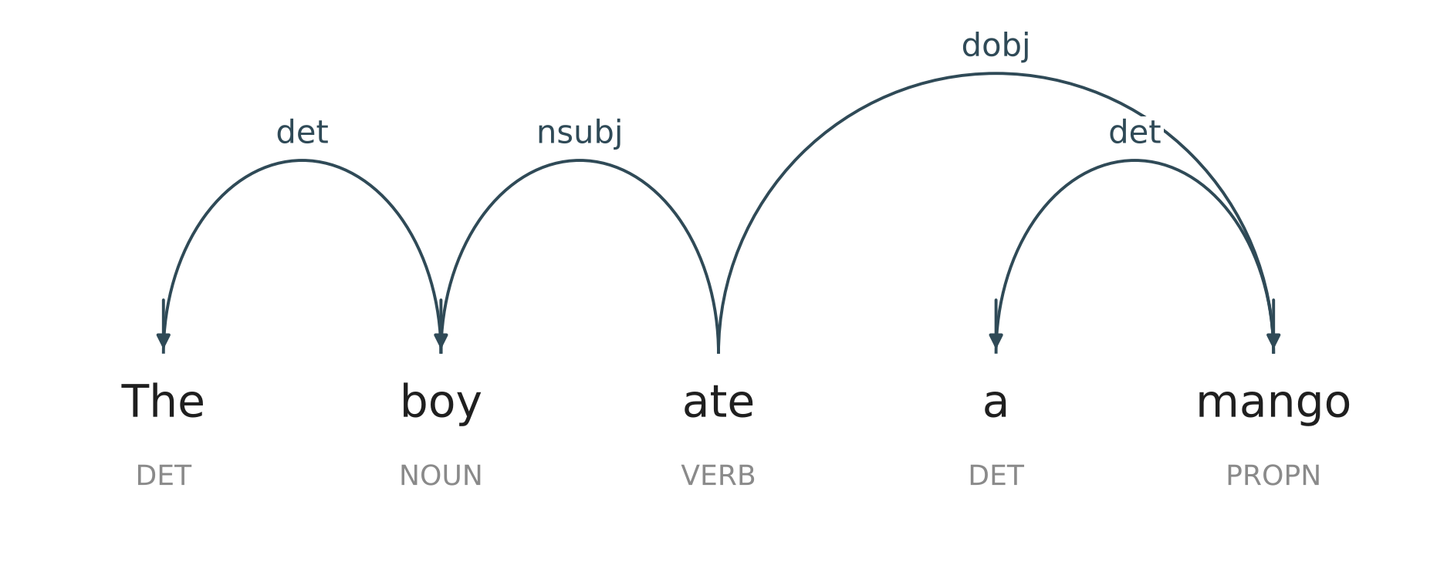
Dependencies and word order
II · LEVELS OF LINGUISTIC ANALYSIS
A dependency parse (spaCy, real output)
Every word depends on a head. The verb ate is the root; boy is its subject (nsubj) and mango its direct object (dobj); each determiner (det) depends on its noun.
spaCy tagged ‘mango’ as PROPN here: even good taggers make mistakes.
Same roles, different order
English (SVO)
The boy S
ate V
a mango O
S subject V verb O object
A parser trained on English word order cannot simply be reused for Hindi.
Hindi (SOV)
laṛke ne S
ām O
khāyā V
Notes:
The dependency diagram is real output from spaCy's en_core_web_sm (note that it tags 'mango' as PROPN, a small tagging error worth pointing out). The lower half compares word order: the same grammatical roles appear in a different order in English (SVO) and Hindi (SOV), and Hindi marks the subject with the postposition ne in the perfective.

Slide 19
Semantics: literal meaning
II · LEVELS OF LINGUISTIC ANALYSIS
Semantics studies the literal, context-independent meaning of words and sentences, and how meanings combine.
EXAMPLE · LEXICAL RELATIONS
Synonymy
big / large; sundar / khūbsūrat
KEY CONCEPTS
Antonymy
hot / cold; din / rāt
Lexical semantics word meanings and the relations between them
Compositionality the meaning of the whole comes from its parts and their structure: dog bites man ≠ man bites dog
Semantic roles agent, patient, instrument, location …
Truth conditions what the world must be like for a sentence to be true
Hyponymy
mango is a kind of fruit
Homonymy
bank (river) / bank (money)
Polysemy
head of a person / head of a department
In NLP. Word sense disambiguation, WordNet / IndoWordNet, semantic role labelling and natural language inference.
Notes:
Semantics is meaning without context: what the sentence would mean said by anyone, anywhere. Keep this definition handy for the assignment, which contrasts it with pragmatics.

Slide 20
Meaning as a network: hyponymy in WordNet
II · LEVELS OF LINGUISTIC ANALYSIS
mango, sense 1: the fruit
mango, sense 2: the tree
food
woody plant
is-a ↓
produce
tree
edible fruit
angiospermous tree
mango
banana
apple
fruit tree
mango
guava
apple tree
Reading the tree: each line is an ‘is a kind of’ link (hyponymy). Siblings such as mango, banana and apple are co-hyponyms: a paradigm of fruits. One word, two senses, two places in the network.
Notes:
Both chains are real WordNet 3.0 hypernym paths (via NLTK), shown from the middle levels down. The word 'mango' has two noun senses in WordNet, the fruit and the tree, and they sit in completely different parts of the hierarchy. This is polysemy made visible, and it is how WordNet-based word sense disambiguation works.

Slide 21
Pragmatics: meaning in context
II · LEVELS OF LINGUISTIC ANALYSIS
Pragmatics studies how context and the speaker's intentions shape what an utterance means beyond its literal content.
EXAMPLE · SAID VS MEANT
“Some students passed.”
implicates: not all of them did
KEY CONCEPTS
Deixis words whose reference depends on context: I, you, here, now, tomorrow
Speech acts utterances do things: promise, request, warn (Austin, Searle)
Implicature what is suggested but not said (Grice)
Presupposition what is taken for granted
“Ravi stopped smoking.”
presupposes: Ravi used to smoke
“See you here tomorrow.”
who, where, when depend on context
“Lovely weather!” (in a storm)
sarcasm: means the opposite
In NLP. Intent recognition, dialogue systems, and detecting sarcasm, metaphor and humour.
Notes:
Pragmatics is where most NLP systems still struggle. The textbook has a full chapter on 'incongruous' text: sarcasm, metaphor and humour, all pragmatic phenomena.

Slide 22

Said vs meant: pragmatics in everyday talk
II · LEVELS OF LINGUISTIC ANALYSIS
WHAT IS SAID
WHAT IS MEANT
PHENOMENON
“Can you pass the salt?”
Please pass me the salt.
Indirect speech act
“Some of the students passed.”
Not all of them passed.
Implicature
“Lovely weather today! (in a storm)”
This weather is awful.
Sarcasm
“I'll see you here tomorrow.”
Meena will meet Ravi at this library on Friday.
Deixis
Semantics gives the literal meaning (left); pragmatics explains how listeners recover the intended meaning (right).
Notes:
Use these as a quick-fire class exercise: show the speech bubble, ask what the speaker means, then reveal the thought bubble. The phenomenon labels on the right connect each scene to the key concepts on the previous slide, and feed directly into the assignment.

Slide 23
Discourse: language beyond the sentence
II · LEVELS OF LINGUISTIC ANALYSIS
Discourse analysis studies how sentences connect to form coherent texts and conversations.
EXAMPLE · SAME FORM, DIFFERENT LINKS
Ravi dropped the glass. It broke.
KEY CONCEPTS
It = the glass; relation: cause → result
Cohesion explicit links: pronouns, connectives (because, however)
Coherence the text makes sense as a whole
Anaphora a word that points back to an earlier one
Discourse relations cause, contrast, elaboration, sequence
Ravi dropped the glass. He was tired.
He = Ravi; relation: explanation
A: Coming to the movie?
B: I have an exam tomorrow.
Coherent only if we infer B's answer is ‘no’.
In NLP. Coreference resolution, summarisation and multi-turn dialogue all need discourse.
Notes:
The last example sits on the border of discourse and pragmatics: coherence depends on an inference about intention.

Slide 24
Following the chains: coreference and discourse relations
II · LEVELS OF LINGUISTIC ANALYSIS
Ravi dropped the glass on the kitchen floor. It shattered. He swept up the pieces and threw them in the bin, then called his mother.
Chain 1
Ravi
He
his
Same entity, different forms: a coreference system must link each pronoun back to its antecedent.
Chain 2
the glass
It
Chain 3
the pieces
them
DISCOURSE RELATIONS IN THE PASSAGE
dropped the glass cause → result It shattered
swept up the pieces sequence then called his mother
Notes:
Colour each chain on the board as students read the passage. Note that spaCy's small model, used in the lab, does not resolve coreference: that needs a dedicated model. The discourse relations at the bottom show that coherence also comes from how sentences relate, not just from shared referents.

Slide 25
Lexicology: the study of words and vocabulary
II · LEVELS OF LINGUISTIC ANALYSIS
Lexicology studies the words of a language: their forms, meanings, origins and how the vocabulary is organised.
EXAMPLE · A LEXICAL ENTRY
bank
noun · plural banks
KEY CONCEPTS
Lexeme vs word form eat, ate, eaten are forms of one lexeme EAT
Word formation derivation, compounding, borrowing (Hindi skūl from English school)
Multiword expressions kick the bucket; nau do gyārah honā (‘to run away’)
Lexicography the applied craft of making dictionaries
Sense 1
a financial institution
Sense 2
the sloping land beside a river
Synonyms
(1) lender; (2) shore, riverside
Hypernyms
(1) institution; (2) slope
Hindi
(1) baink; (2) kinārā / taṭ
In NLP. Lexicons and lexical networks such as WordNet and IndoWordNet; sentiment lexicons; multiword-expression detection.
Notes:
IndoWordNet, a lexical network for Indian languages, is among Prof. Bhattacharyya's best-known contributions. Lexicology overlaps with morphology (word formation) and semantics (word meaning), which is why it sits beside the stack.

Slide 26





How new words enter a language
II · LEVELS OF LINGUISTIC ANALYSIS
Borrowing
Compounding
Derivation
school → skūl (Hindi)
yoga, karma, pyjama → English
rail + way → railway
rasoī + ghar → rasoīghar ‘kitchen’
happy → happiness
sundar → sundartā ‘beauty’
Blending
Clipping
Acronyms
smoke + fog → smog
Hindi + English → Hinglish
laboratory → lab
advertisement → ad
Indian Institute of Technology → IIT
light amplification by stimulated emission of radiation → laser
Notes:
Lexicology studies where words come from. Indian languages offer rich examples of borrowing in both directions: English has taken words such as yoga, karma and pyjama, and Hindi has taken school, station and doctor. Ask students to find one example of each process from their own speech.

Slide 27
Putting it together: one utterance at every level
II · LEVELS OF LINGUISTIC ANALYSIS
“Can you close the window? It's freezing.”
LEVEL | WHAT THE ANALYSIS FINDS
Phonetics / phonology | Rising intonation at the end of the first sentence marks a yes/no question
Morphology | freez-ing (verb + progressive suffix); it's = it + is
Syntax | Sentence 1: auxiliary-first interrogative (Aux Subj V NP); sentence 2: declarative
Semantics | Literally asks about the hearer's ability; states that the temperature is below 0 °C
Pragmatics | Actually a polite request; “freezing” is exaggeration for “very cold”
Discourse | Sentence 2 explains sentence 1 (relation: reason); “it” refers to the weather
Lexicology | freezing is used in an extended, non-literal sense; close the window is a frequent collocation
Notes:
Use this as a classroom exercise: give the sentence first, ask groups to fill each level, then reveal. It previews the assignment: notice how semantics and pragmatics give different answers for the same sentence.

Slide 28

Artificial intelligence and its sub-disciplines
III
Where natural language processing sits within AI

Slide 29



What is artificial intelligence?
III · ARTIFICIAL INTELLIGENCE
AI is the study and design of computer systems that perform tasks which, in humans, require intelligence: perceiving, reasoning, learning, communicating and acting. The term was coined by John McCarthy for the 1956 Dartmouth workshop.
FOUR VIEWS OF AI (RUSSELL & NORVIG)
HUMAN-LIKE
RATIONAL
THINKING
Thinking humanly
Model how people think: cognitive modelling
Cognitive science (Session 1)
Thinking rationally
Reason correctly using logic: the ‘laws of thought’
Logical languages (Session 1)
ACTING
Acting humanly
Behave indistinguishably from a person
The Turing test (1950): a conversation test
Acting rationally
Act to achieve the best expected outcome
The rational-agent view used by most modern AI
Notes:
The Turing test is highlighted because it is a language test: a machine passes if its conversation is indistinguishable from a person's. NLP was part of AI's definition from the start. Reference: Russell & Norvig, Artificial Intelligence: A Modern Approach, Ch. 1.

Slide 30
The sub-disciplines of AI, and where NLP fits
III · ARTIFICIAL INTELLIGENCE
SUB-DISCIPLINE | CONCERNED WITH
Knowledge representation & reasoning | Encoding facts and drawing inferences
Search and planning | Finding sequences of actions to reach goals
Machine learning | Learning patterns from data; deep learning uses neural networks
Natural language processing | Understanding, generating and interacting in human language
Computer vision | Interpreting images and video
Speech processing | Recognising and synthesising spoken language
Robotics | Perception and action in the physical world
Expert systems | Encoding human expertise as rules
ARTIFICIAL INTELLIGENCE
NLP
also draws on linguistics
Machine learning
Deep learning
Link to Session 1: NLP's three generations draw on knowledge representation (rules), machine learning (statistics) and deep learning (neural networks).
Notes:
NLP overlaps machine learning and deep learning but also extends outside them, because it depends on linguistic knowledge (the first half of this session). Speech processing is often grouped with NLP; it is the bridge between phonetics/phonology and text.

Slide 31
Understanding, generation and interaction
IV
The three broad capabilities of language-using systems

Slide 32
NLP = understanding + generation, inside an interaction
IV · NLU, NLG AND NLI
NLI: NATURAL LANGUAGE INTERACTION (repeated turn after turn)
Text or speech in
“Book a flight from Mumbai to Delhi”
NLU
understand
Meaning representation
intent: book_flight
from: Mumbai to: Delhi
NLG
generate
Text or speech out
“Searching flights from Mumbai to Delhi.”
NLU
Natural Language Understanding
NLG
Natural Language Generation
NLI
Natural Language Interaction
Maps language to a representation of its meaning. Analysis: from form to function and meaning.
Maps a meaning representation or data to fluent language. Synthesis: from meaning to form.
Combines NLU and NLG in a dialogue, keeping track of context across turns.
Notes:
NLU is analysis (form to meaning); NLG is synthesis (meaning to form). Every level from Part II can be run in either direction. NLI wraps both in a conversation and adds memory of context. Lab Task 3 builds exactly this pipeline in about 25 lines of Python.

Slide 33
Natural Language Understanding (NLU)
IV · NLU, NLG AND NLI
NLU converts text or speech into a structured representation of its meaning that a machine can act on.
EXAMPLE · INTENT AND SLOTS
“Book me a flight from Mumbai to Delhi tomorrow morning.”
TYPICAL NLU TASKS
TASK | OUTPUT | TEXTBOOK
POS tagging, chunking | word categories, phrases | Ch. 3
Parsing | syntactic structure | Ch. 4
Named entity recognition | people, places, organisations | Ch. 5
Natural language inference | entails / contradicts / neutral | Ch. 6
Sentiment analysis | positive / negative / neutral | Ch. 8
Question answering | an answer span or text | Ch. 9
{
"intent": "book_flight",
"from": "Mumbai",
"to": "Delhi",
"date": "tomorrow",
"time": "morning"
}
The hard part is ambiguity: “Mumbai to Delhi” vs “Delhi from Mumbai”, or “not tomorrow, Friday”.
In NLP. Across all three generations (rules, statistics, neural), NLU is the problem of resolving ambiguity at every layer.
Notes:
Note: in the textbook, 'NLI' in Chapter 6 means Natural Language Inference, an NLU task. In this session's syllabus, NLI means Natural Language Interaction. Point the difference out to students to avoid confusion.

Slide 34
What NLU extracts: entities in a sentence
IV · NLU, NLG AND NLI
Book
me
a
flight
from
Mumbai
to
Delhi
tomorrow
morning
with
Air India
.
GPE
GPE
DATE
missed (TIME)
ORG
GPE country, city or state DATE date ORG organisation
FROM ENTITIES TO A MEANING REPRESENTATION
intent
book_flight
from the verb “Book” + “flight”
from
Mumbai
GPE after “from”
to
Delhi
GPE after “to”
date
tomorrow
DATE entity
time
morning
needs a rule: NER missed it
airline
Air India
ORG entity
Notes:
Entity labels are real output from spaCy en_core_web_sm. Note what it gets right (two places, a date, an airline) and what it misses: 'morning' is not tagged as a TIME. The slot-filling step below is what a flight-booking NLU component adds on top of generic NER, using cues like 'from' and 'to'.

Slide 35
Natural Language Generation (NLG)
IV · NLU, NLG AND NLI
NLG produces fluent, appropriate text or speech from data, a meaning representation, or another text.
THE CLASSIC NLG PIPELINE (REITER & DALE)
1. Content determination
What to say
2. Document planning
In what order
3. Microplanning
Word choice, aggregation, pronouns
4. Surface realisation
Grammatical sentences
EXAMPLE · DATA TO TEXT
{ "city": "Mumbai",
"temp_c": 31,
"humidity": "high",
"rain_chance": 0.7 }
“It's a humid 31 °C in Mumbai today, with a good chance of rain. Carry an umbrella.”
Notice the choices: “humid” (lexicalisation), one sentence for two facts (aggregation), and advice the data never stated (content determination).
In NLP. Machine translation, summarisation, report generation and generative LLMs; methods moved from templates to statistical to neural.
Notes:
Template NLG (Lab Task 3) does surface realisation with fixed sentences. Large language models fold all four stages into one network, which makes them fluent but harder to control: they can generate content that the data does not support.

Slide 36
Natural Language Interaction (NLI): systems that converse
IV · NLU, NLG AND NLI
NLI lets people interact with machines through dialogue in natural language, typed or spoken, over many turns.
tracks the conversation state and decides the next action
User
Speech recognition (ASR)
NLU
Dialogue manager
NLG
Speech synthesis (TTS)
response, then the next turn
Task-oriented
Open-domain
Question answering
Completes a goal in few turns
e.g. IRCTC ticket booking, banking bots
Chit-chat on any topic
e.g. social chatbots, general LLM assistants
Answers information needs
e.g. customer support, search assistants
In NLP. NLI adds what single-sentence NLU lacks: memory of context, turn-taking and pragmatic inference. Note: in the textbook, NLI in Ch. 6 means natural language inference.
Notes:
The textbook organises conversational AI by the same three generations: rule-based (ELIZA-style pattern matching), statistical, and neural. The dialogue manager is the new component compared with plain NLU and NLG: it remembers what has been said and decides what to do next.

Slide 37
What NLI looks like: a conversation that remembers
IV · NLU, NLG AND NLI
Flight assistant
I want to fly to Delhi.
NLU: intent book_flight; to = Delhi
Sure. Which city are you flying from?
Dialogue manager: ‘from’ is missing, so ask for it
Mumbai, tomorrow.
NLU + context: from = Mumbai, date = tomorrow; intent remembered
Mumbai → Delhi, tomorrow. Morning or evening?
NLG: confirm what is known; ask about time
Morning, please.
NLU + context: time = morning; all slots now filled
I found 3 morning flights. The first leaves at 7:10.
Action + NLG: query flights, then report the result
Turns 3 and 5 only make sense because the system remembers earlier turns: this is the discourse and pragmatics work that NLU alone cannot do.
Notes:
A mock-up of a well-behaved task-oriented assistant. Compare it with the lab bot, which forgets the intent after one turn. The annotations show which component does the work at each turn: NLU, the dialogue manager (which keeps state across turns), and NLG.

Slide 38
NLU, NLG and NLI compared
IV · NLU, NLG AND NLI
 | NLU | NLG | NLI
Direction | Language → meaning | Meaning or data → language | Both, repeatedly
Input | Text or speech | Data, a meaning representation, or text | A user's turns in a dialogue
Output | Structured representation | Fluent text or speech | Responses and actions
Core challenge | Ambiguity at every layer | Choosing what to say and how | Context across turns; pragmatics
Linguistic levels most used | Morphology → semantics | Semantics → syntax → morphology | Pragmatics and discourse
Example systems | Spam filters, NER, sentiment tools | Translation, summaries, reports | Chatbots, voice assistants
A useful summary. NLU runs the levels of analysis upward, NLG runs them downward, and NLI keeps both running in a loop.
Notes:
Return to the levels stack from Part II and trace the direction of each capability on it.

Slide 39

From levels of analysis to dialogue
Lab
Two hours · Python 3.9+, NLTK (gutenberg, wordnet), spaCy (en_core_web_sm)

Slide 40
Lab plan
ACTIVITY | WHAT STUDENTS DO | OUTPUT
Setup | pip install nltk spacy python -m spacy download en_core_web_sm | Working environment
Task 1: Two axes (Part I) | Extract collocations from a novel (syntagmatic); explore WordNet synonyms and hypernyms (paradigmatic) | Ten collocations, three synsets explained
Task 2: Levels (Part II) | Run spaCy on a sentence; label each output column with the linguistic level it belongs to | Annotated table: token, lemma, morphology, POS, dependency, entities
Task 3: NLU → NLG → NLI (Part IV) | Extend a rule-based flight bot: add a date slot, a new intent and a reply template | Working bot and a transcript
Wrap-up | Which levels did spaCy cover, and which did the bot ignore? | Class discussion
Notes:
Total 120 minutes. All code has been tested with Python 3, NLTK and spaCy en_core_web_sm. NLTK data needs: nltk.download('gutenberg'); nltk.download('wordnet').

Slide 41
Two axes with NLTK; linguistic levels with spaCy
LAB · TASKS 1 AND 2
Task 1 · Paradigmatic and syntagmatic
Task 2 · A sentence through the levels
import nltk
from nltk.collocations import (
BigramCollocationFinder, BigramAssocMeasures)
from nltk.corpus import gutenberg, wordnet as wn
# Syntagmatic: which words keep company?
words = [w.lower() for w in
gutenberg.words("austen-emma.txt")
if w.isalpha()]
f = BigramCollocationFinder.from_words(words)
f.apply_freq_filter(5)
print(f.nbest(BigramAssocMeasures.pmi, 10))
# Paradigmatic: which words can replace each other?
for syn in wn.synsets("car")[:3]:
print(syn.name(), syn.lemma_names(),
[h.name() for h in syn.hypernyms()])
import spacy
nlp = spacy.load("en_core_web_sm")
doc = nlp("The children in Pune didn't eat "
"the mangoes because they were raw.")
for t in doc:
print(t.text, t.lemma_, t.morph,
t.pos_, t.dep_, t.head.text)
print(doc.ents)
# Label each column with its level:
# lemma, morph -> morphology
# pos_, dep_ -> syntax
# ents -> semantics (entities)
# Which word does "they" refer to?
# (discourse: spaCy does not say)
Sample output: (‘sore’, ‘throat’), (‘baked’, ‘apples’); car.n.01 → motor_vehicle.n.01
Sample output: children child Number=Plur NOUN nsubj eat
Notes:
Task 1 PMI favours rare but tightly bound pairs, so names and fixed phrases dominate (Brunswick Square, sore throat). Ask students to try BigramAssocMeasures.likelihood_ratio and compare. Task 2: spaCy covers morphology, syntax and named entities; it does not resolve 'they' (discourse) or interpret intention (pragmatics).

Slide 42
What you should see: real output of Tasks 1 and 2
LAB · TASKS 1 AND 2
Task 1 · Collocations in Emma (PMI)
Task 2 · spaCy, one row per token
1. barouche landau
2. o clock
TOKEN
LEMMA
morphology
MORPH
morphology
POS
syntax
DEP
syntax
HEAD
syntax
3. court plaister
4. brunswick square
The
the
Def, Art
DET
det
children
5. sore throat
6. d ye
children
child
Plur
NOUN
nsubj
eat
7. don t
8. mill farm
in
in
ADP
prep
children
9. william larkins
10. baked apples
Pune
Pune
Sing
PROPN
pobj
in
did
do
Past, Fin
AUX
aux
eat
Task 1 · WordNet senses of ‘car’
n't
not
Neg
PART
neg
eat
eat
eat
Inf
VERB
ROOT
eat
car.n.01
car, auto, automobile, machine, motorcar
is a kind of motor_vehicle
the
the
Def, Art
DET
det
mangoes
mangoes
mango
Plur
NOUN
dobj
eat
car.n.02
car, railcar, railway car, railroad car
is a kind of wheeled_vehicle
because
because
SCONJ
mark
were
they
they
Nom, Plur, 3
PRON
nsubj
were
were
be
Past, Ind
AUX
advcl
eat
car.n.03
car, gondola
is a kind of compartment
raw
raw
Pos
ADJ
acomp
were
Entities: (Pune,) · ‘they’ is not linked to ‘mangoes’: discourse is outside spaCy's pipeline.
Notes:
All values on this slide are real output from running the lab code (NLTK Gutenberg 'austen-emma.txt', WordNet 3.0, spaCy en_core_web_sm). PMI favours rare but fixed pairs, so names and set phrases come first. In the spaCy table, notice what is missing: nothing links 'they' to 'mangoes' (discourse).

Slide 43
A mini dialogue system: NLU → NLG inside an NLI loop
LAB · TASK 3
import re
def understand(text): # NLU
t = text.lower()
intent = ("book_flight"
if re.search(r"\b(book|fly|flight)\b", t)
else "unknown")
m = re.search(r"from (\w+) to (\w+)", t)
slots = {"from": m.group(1), "to": m.group(2)} if m else {}
return intent, slots
def generate(intent, slots): # NLG
if intent == "book_flight" and slots:
return (f"Searching flights from {slots['from'].title()}"
f" to {slots['to'].title()}.")
if intent == "book_flight":
return "Sure. Where are you flying from, and to?"
return "Sorry, I can only help with flights."
while True: # NLI loop
user = input("You: ")
if user.lower() in {"bye", "exit"}:
break
print("Bot:", generate(*understand(user)))
SAMPLE TRANSCRIPT
You: I want to book a flight
Bot: Sure. Where are you flying from, and to?
You: from Mumbai to Delhi
Bot: Sorry, I can only help with flights.
Exercises
1. Why did the bot fail on turn 2? (Hint: it has no memory of the intent: a discourse problem.)
2. Add a date slot (today, tomorrow, a weekday).
3. Add a cancel_booking intent with its own reply.
Notes:
The transcript is real output. Turn 2 fails because each turn is understood in isolation: there is no dialogue state. Fixing it means storing the last intent between turns, which is exactly the job of the dialogue manager on the NLI slide.

Slide 44
Readings for self-learning
SELF-LEARNING
READINGS
SELF-CHECK
Bhattacharyya, P. & Joshi, A. (2023). Natural Language Processing. Wiley India. §1.2 and Ch. 10 Conversational AI (introduction).
1
Give one syntagmatic and one paradigmatic relation for the word “tea”.
2
Find a Hindi minimal pair not used in class.
Fromkin, V., Rodman, R. & Hyams, N. An Introduction to Language: chapters on morphology, syntax and meaning.
3
Segment three Hindi or Marathi words into morphemes.
Russell, S. & Norvig, P. Artificial Intelligence: A Modern Approach, Ch. 1 Introduction.
4
Name the AI sub-discipline behind each NLP generation.
5
Is a weather-report generator NLU, NLG or NLI? Why?
Notes:
About 40 minutes of reading and 20 minutes on the self-check. The assignment on the next slide is submitted separately.

Slide 45
Assignment: the difference between semantics and pragmatics
ASSIGNMENT
Task. Write 800–1,000 words explaining how semantics and pragmatics differ, with examples, and why the difference matters for NLP. Submit before Session 3.
YOUR ANSWER SHOULD COVER
ANALYSE EACH SENTENCE AT BOTH LEVELS
Clear definitions of each field
Sentence meaning vs speaker meaning
Context-independent vs context-dependent meaning
At least three pragmatic phenomena: deixis, implicature, presupposition, speech acts
Where the boundary is hard to draw
Why chatbots and LLMs need pragmatics, not only semantics
(1)
Can you open the window?
(2)
Some of the students passed.
(3)
I'll meet you here tomorrow.
(4)
Ravi has stopped smoking.
(5)
Great, another Monday! (said with a groan)
CRITERION | Conceptual clarity | Analysis of examples | NLP relevance | Writing and references
WEIGHT | 30% | 30% | 20% | 20%
Notes:
Each example sentence targets one phenomenon: (1) indirect speech act, (2) scalar implicature, (3) deixis, (4) presupposition, (5) sarcasm. Students should give the literal (semantic) meaning and then the contextual (pragmatic) meaning for each. Encourage use of the Pragmatics and Semantics slides from this session as a starting point, not as the answer.

Slide 46
Key takeaways
SUMMARY
1
Language analysis works along two axes (syntagmatic and paradigmatic) and asks of every unit: what is its form, its function, and its meaning?
2
Linguistic levels run from phonetics to discourse, with lexicology across them; each level has a matching NLP task.
3
AI is the wider field; NLP draws on its sub-disciplines and on linguistics.
4
NLU, NLG and NLI are understanding (analysis), generation (synthesis), and interaction (both, in a loop).
For discussion. An LLM chatbot is fluent (NLG) but sometimes misreads what you meant. Which linguistic level is it failing at?
Notes:
Expected answer to the discussion: usually pragmatics or discourse (intent and context), occasionally semantics (word sense). This sets up the assignment.

